Slide 1
Generating Insights from Clustering Large Donors
Brad Stieber Data Analyst, Wisconsin Foundation and Alumni Association Brad.Stieber@supportuw.org | bgstieber.github.io

Slide 2
About this Talk
Background
Large Donor Disruption
What is Unsupervised Learning
Three Clustering Algorithms
An Example from WFAA
Wrapping Up
Notes:
First, provide some information about my background, then lay the foundation for talking about UL, and finally discuss
How we’ve used it at WFAA to cluster our large donors, and why that group is so important

Slide 3
About Me
Data Scientist with experience in private finance, non-profit, and law enforcement
Passionate about communicating quantitative information effectively
Main tools are R, SQL, and Tableau
Frequently quote Box, Tukey, and Wickham
All models are wrong, but some are useful.
George Box
The best thing about being a statistician is that you get to play in everyone’s backyard.
John Tukey
Tidy datasets are all alike, but every messy dataset is messy in its own way.
Hadley Wickham

Slide 4
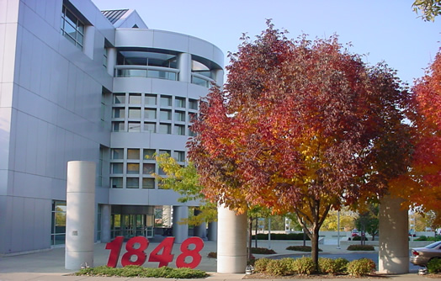

About WFAA
Official fundraising and gift-receiving organization for the UW–Madison
In the midst of a $3.2B campaign, ending in 2020
Staff of 300: 70 development officers, 13 in Data Solutions Team (DW, BI, DA), 13 in Research

Slide 5
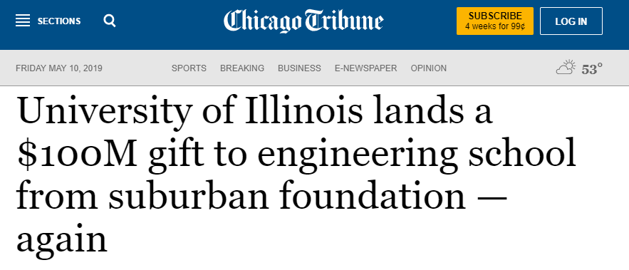
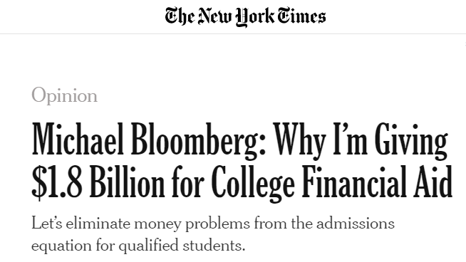
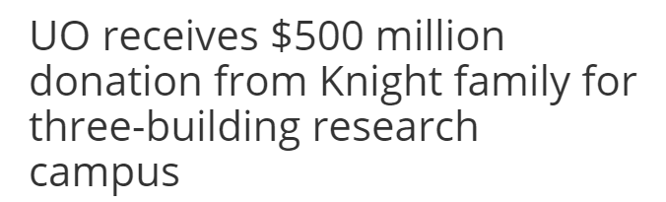
Large Donor Disruption – Overview
Growing wealth inequality
Deviation from 80/20
Large gifts in the news
Insights from Wealth-X’s World Ultra Wealth Report (2018):
Philanthropic activity is now one of the main interests of the ultra wealthy.
The Giving Pledge points to an increasing awareness that the ultra wealthy need to be seen to be giving something back to society.
There is a growing popularity of alternative methods of philanthropy, such as donor-advised funds and impact investment vehicles.

Slide 6
Trend in Wealth and Income Inequality

Slide 7
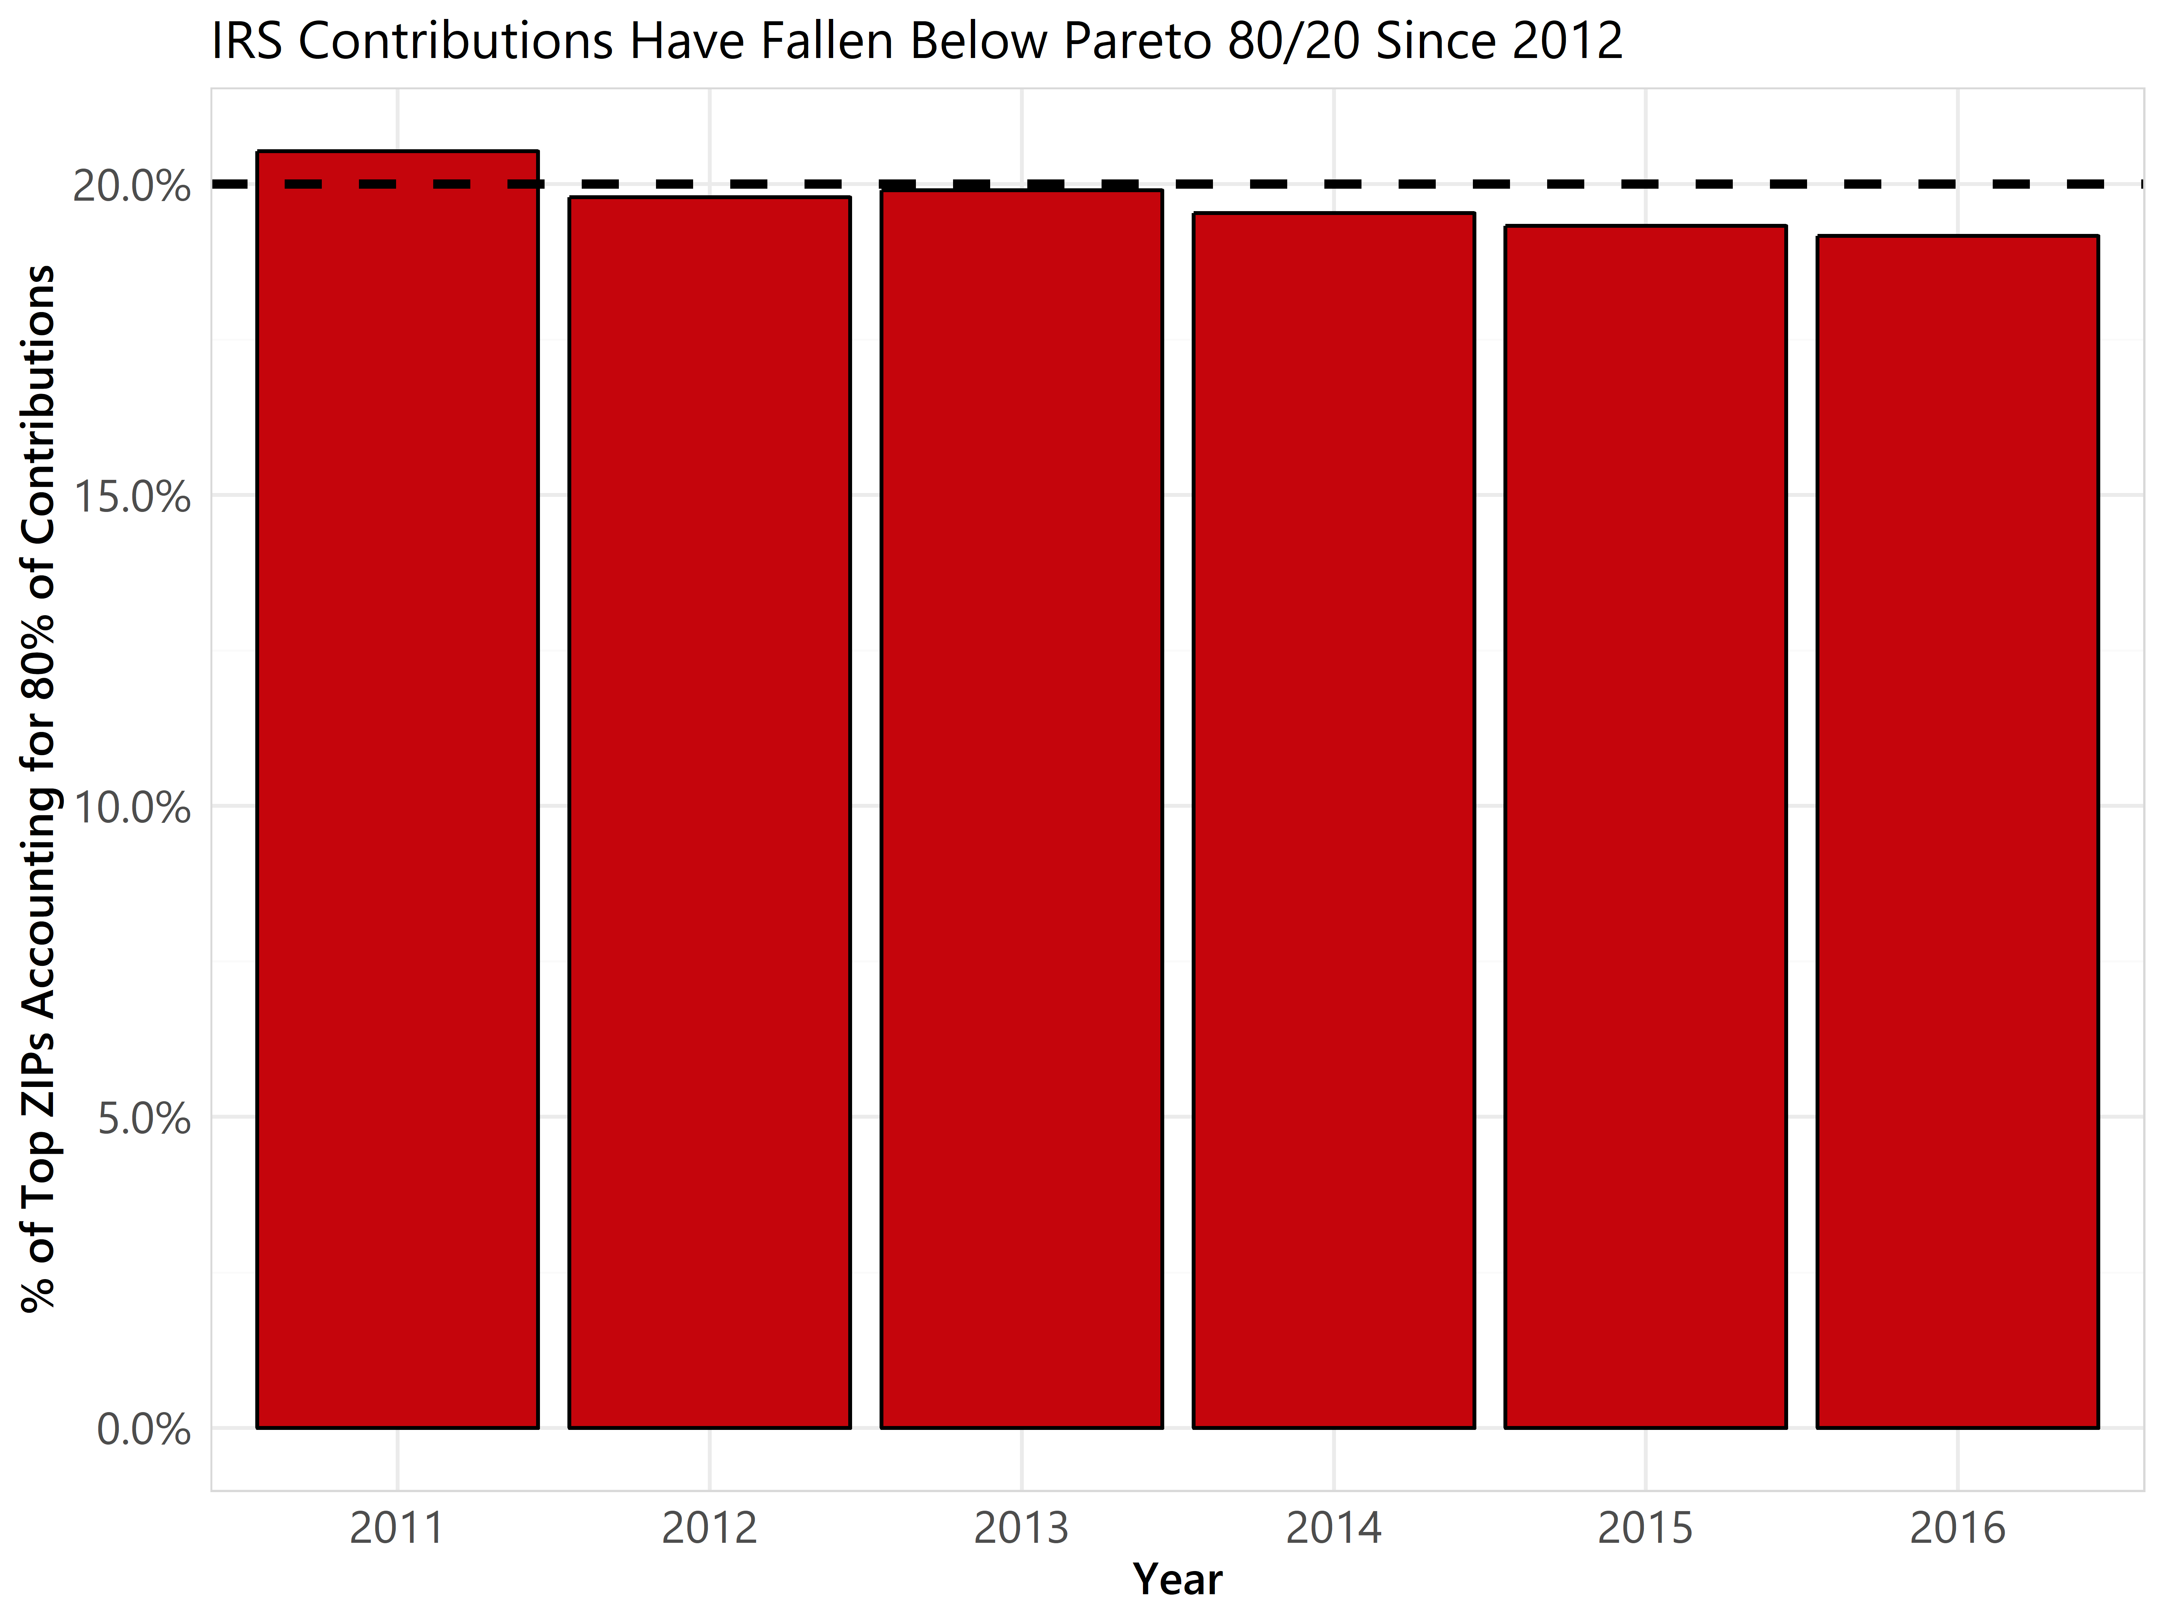
Large Donor Disruption – IRS Data
Tax return data is available by ZIP
Aside: useful in ML
How does the 80/20 “rule” hold up using charitable contributions on tax returns?
What does this tell us about large donors?

Slide 8
Large Donor Disruption – WFAA Data
WFAA giving deviates from Pareto 80/20
Trending toward larger deviation

Slide 9
Large Donor Disruption – Opinions
Large donors have always been important, but their importance is increasing
Also evident in HRC 2016 campaign contributions
Most organizations will have good data on these donors, but might lack ways of analyzing it
What’s the dependent variable?
What you learn about large donors today will help you tomorrow

Slide 10
What we did at WFAA
Used K-Means clustering on our largest donors
$250K+ households, 75% of giving → 0.6% of donor households
Four distinct clusters were found. Providing questions, ideas, and direction for development strategies.
Oldie but a Goodie
X₁ | X₂ | … | X₁₂
0.26 | 0.95 | … | 0.44
0.33 | 0.05 |  | 0.83
0.1 | 0.89 |  | 0.77
Pull data
log-transform
Center and scale
K-Means
Young Whippersnappers
Big Kahuna
Take the Money and Run
Notes:
Add animation?

Slide 11
Unsupervised Learning
We have X (data set), but no y for classification or regression
What can we learn about the underlying structure of the data?
Great for data exploration and initial analyses, but sometimes difficult to generate out-of-sample predictions
y | X
Species | Sepal.Length | Sepal.Width | Petal.Length | Petal.Width
versicolor | 6 | 2.2 | 4 | 1
versicolor | 6.1 | 2.8 | 4 | 1.3
setosa | 5.1 | 3.8 | 1.9 | 0.4
setosa | 5.2 | 3.4 | 1.4 | 0.2
virginica | 6.3 | 2.7 | 4.9 | 1.8
X
Girth | Height | Volume
10.8 | 83 | 19.7
16 | 72 | 38.3
12.9 | 85 | 33.8
10.5 | 72 | 16.4
11 | 75 | 18.2
Supervised learning (iris):
predict y from X
Unsupervised learning (trees):
learn some structure about X

Slide 12
Using UL: Right and Wrong Times
You don’t need to predict a target variable
UL still works for exploratory analysis if you have a target variable
You expect some latent groups/hierarchy in your data
You’re okay with being unable to generate cluster assignments on a new data set (sometimes)
Your data is mainly consists of numeric variables
You have a lot of data, some redundant features, and want to reduce the number of columns

Slide 13
Three UL Techniques You Should Know
K-Means
Hierarchical Clustering
DBSCAN
Bonus: Dimensionality Reduction
Notes:
DBSCAN-Density-based spatial clustering of applications with noise

Slide 14
K-Means
“Hello, world” of clustering algorithms
Simple, effective, and intuitive
Need to specify number of clusters, many methods for determining optimal number of clusters, but depends on context
Scale your data!
Be prepared to interpret the results
Implementations in R, Python, and even Tableau

Slide 15
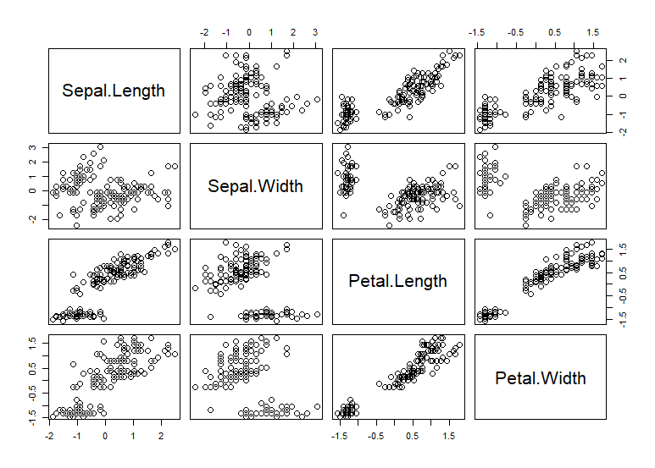
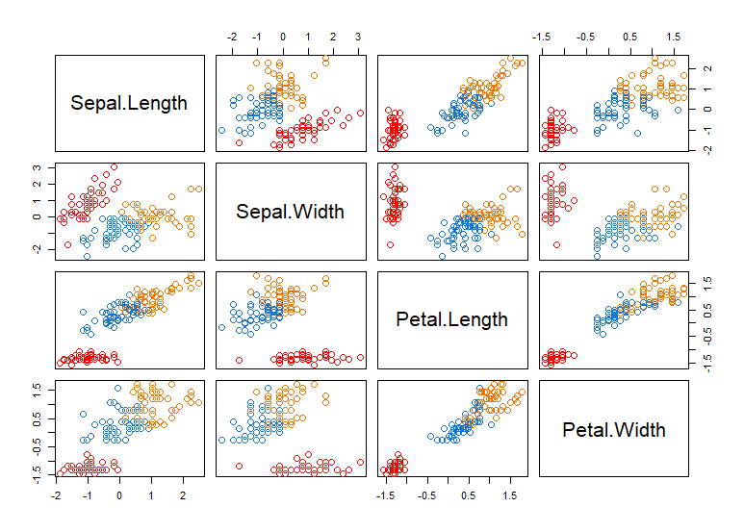
K-Means Example

Slide 16
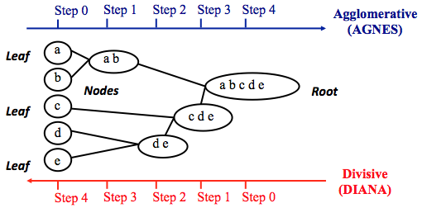
Hierarchical Clustering
Control of how high or low you go on a hierarchy
Does your data have a latent hierarchical structure?
Learn to interpret and explore a dendrogram
More flexible than K-Means, but harder to generate predictions
https://uc-r.github.io/hc_clustering
Notes:
Note that agglomerative clustering is good at identifying small clusters. Divisive hierarchical clustering is good at identifying large clusters.

Slide 17
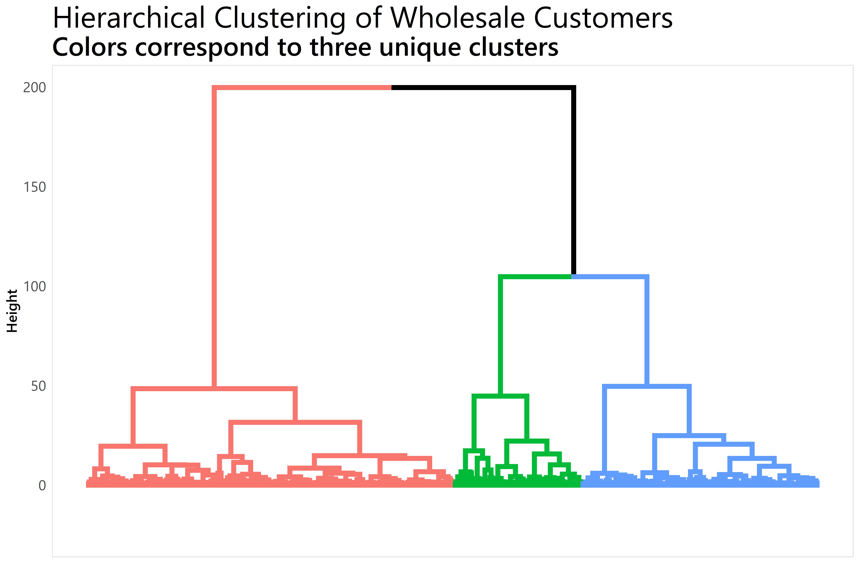
Hierarchical Clustering Example
Channel | Region | Fresh | Milk | Grocery | Frozen | Detergents_Paper | Deli
2 | 3 | 12669 | 9656 | 7561 | 214 | 2674 | 1338
2 | 3 | 7057 | 9810 | 9568 | 1762 | 3293 | 1776
2 | 3 | 6353 | 8808 | 7684 | 2405 | 3516 | 7844
….
Clustering wholesale customers using factoextra R package

Slide 18
DBSCAN
More advanced than K-Means or hierarchical clustering
Useful in outlier detection and is flexible with cluster shape
DBSCAN is “region-based”, trying to identify neighborhoods of densely packed data points
Don’t specify number of clusters, but need to specify epsilon (radius) and minimum points (number of neighbors to be a core point)
Implementations in R and Python, many tutorials to get started
Notes:
DBSCAN-Density-based spatial clustering of applications with noise

Slide 19
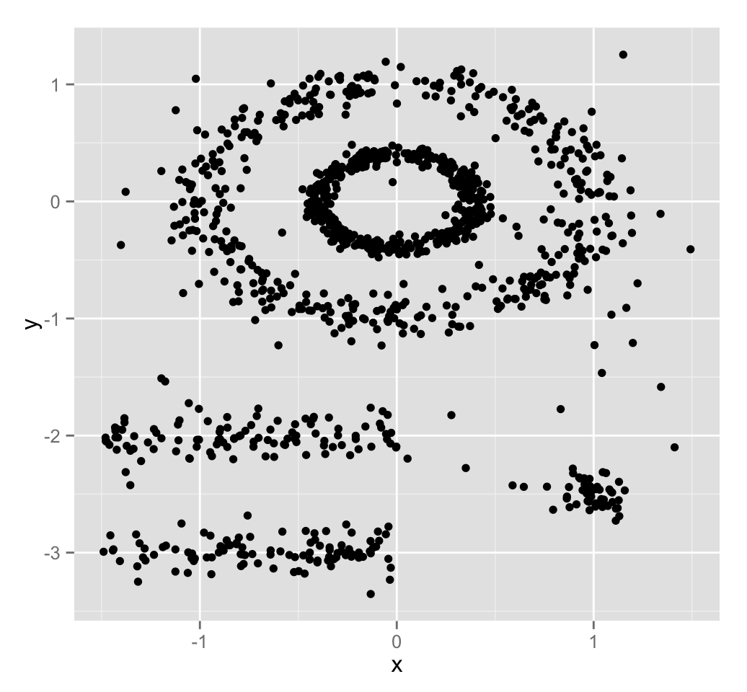
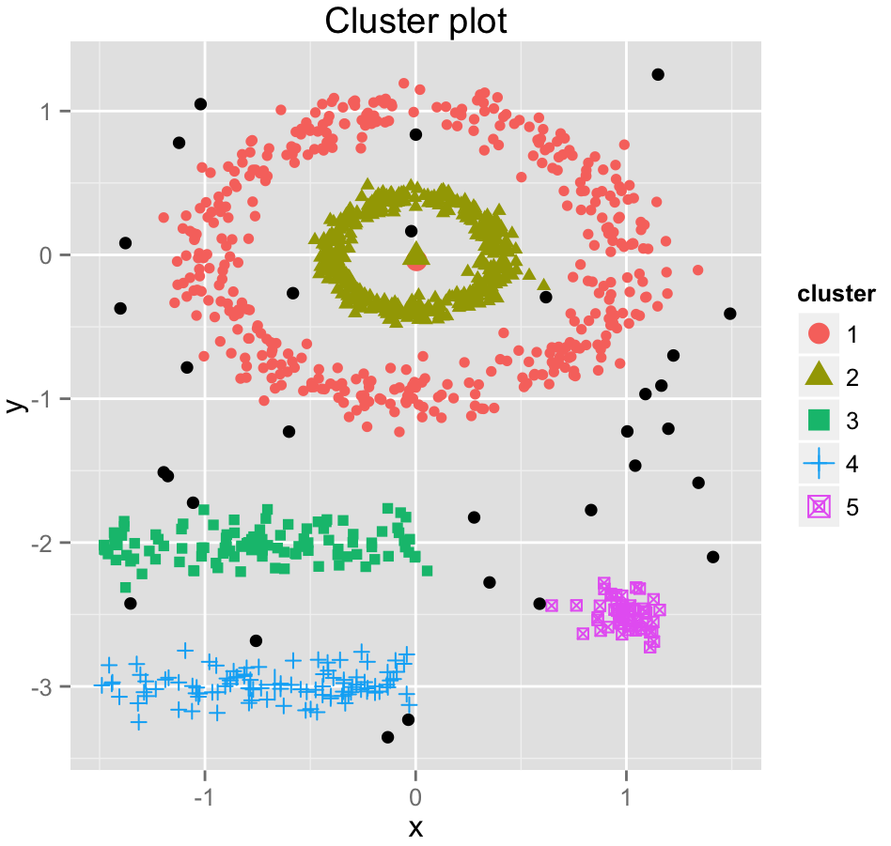
DBSCAN Example
http://www.sthda.com/english/wiki/wiki.php?id_contents=7940

Slide 20
Bonus: Dimensionality Reduction
Large number of data features (columns) makes standard data exploration hard
Redundancy or correlation between variables will affect machine learning algorithms
Helpful for unstructured data (sparse feature space)
Techniques
Principal Component Analysis (“hello, world” of dimensionality reduction)
t-SNE (more advanced algorithm, lots of cool examples on the web)
LASSO (for regression tasks)
By document word2vec summaries

Slide 21
Example from WFAA – Setup
Analytics FAQ
What other donors looks like X? Pathways?
Exploratory analysis on trajectories for large donor society
What else can we learn about these donors?
Nothing to predict, what can we do?

Slide 22
Example from WFAA – Data/Methods
1,150 Households with at least $250K in new gifts and new pledges
Giving is adjusted for inflation (2016 $)
At least one member of household must have valid birth year
At least one member of household must be living, or if all members are deceased, at least one member must have valid death year
Lifetime giving
First gift amount
Most recent gift amount
Giving in first five years of giving career
Giving in last five years of giving career
Count gifts
Largest gift
Age at first gift
Age at most recent gift
Age at largest gift
Age at passing $250K threshold
Days between first gift and passing $250K threshold
Notes:
This top donor group represented about 0.6% of all eligible donors…accounted for 75% of dollars

Slide 23
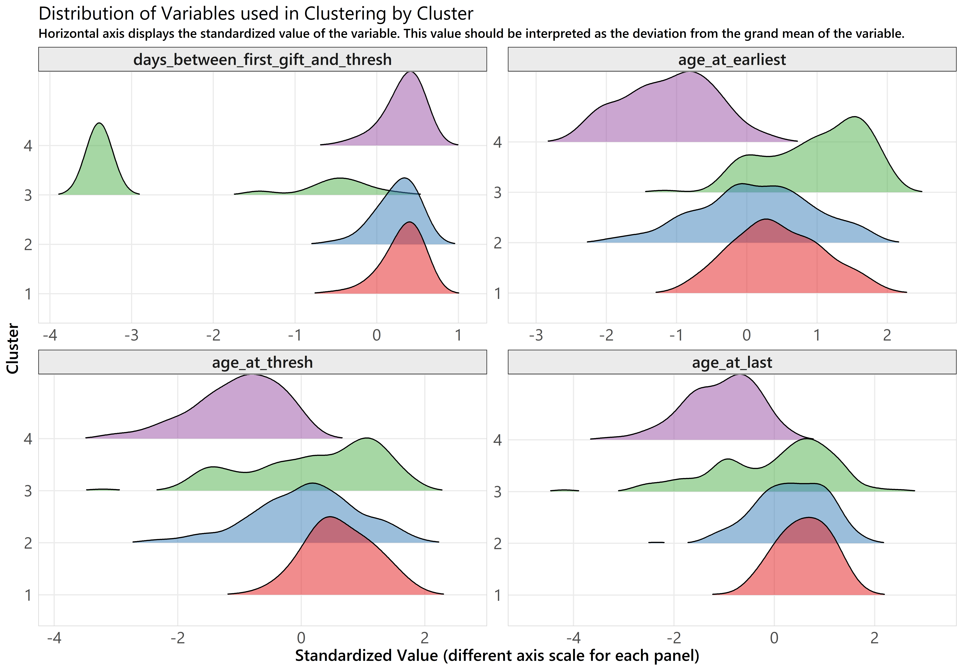
Example from WFAA – Results
Used K-Means on scaled data (log almost everything!)
Found four distinct and interpretable clusters
Cluster 4: Young Whippersnappers (327)
Cluster 3: Take the Money and Run (or Walk) (127)
Cluster 2: Big Kahuna (217)
Cluster 1: Oldie but a Goodie (478)

Slide 24
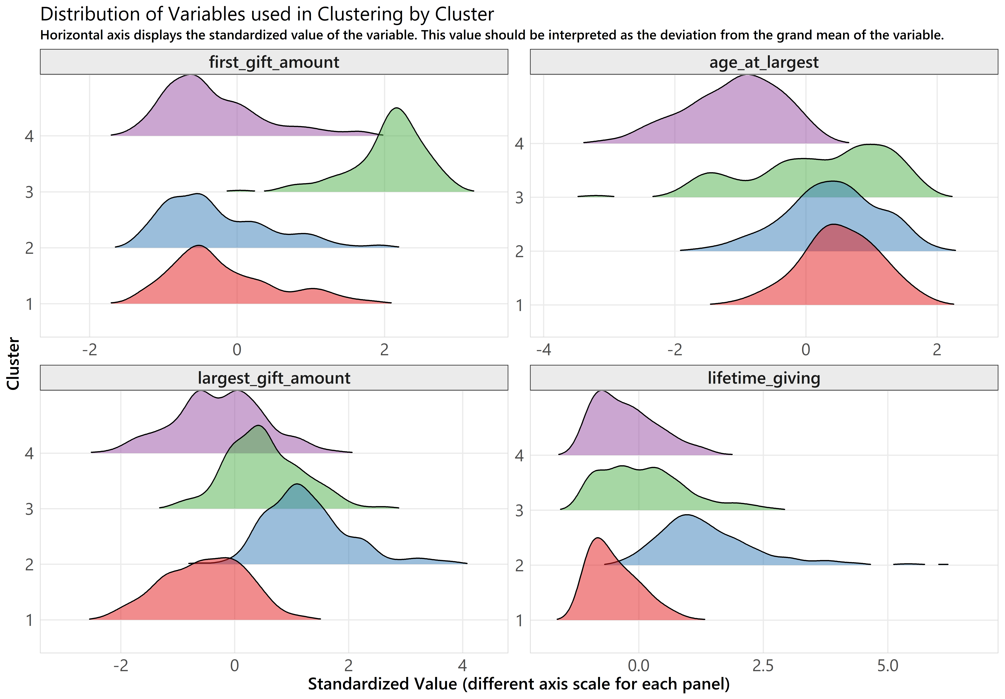
Example from WFAA – Results
Used K-Means on scaled data (log almost everything!)
Found four distinct and interpretable clusters
Cluster 4: Young Whippersnappers (327)
Cluster 3: Take the Money and Run (or Walk) (127)
Cluster 2: Big Kahuna (217)
Cluster 1: Oldie but a Goodie (478)

Slide 25
Example from WFAA – Implementation
More targeted questions about each of the clusters
Used output from kmeans in R to generate paragraph summaries of each cluster
Make development officers more efficient
Can we generalize to the whole?
Prospect | Cluster
Jeffrey Lebowski | ●
Walter Sobchak | ▲
Donald "Donny" Kerabatsos | ■
Brandt | ◄
Future portfolio review?

Slide 26
Wrapping Up – Large Donors
Global trends demonstrate increasing importance of largest donors
We need to learn as much as we can about these donors
Be creative in your data analysis
Existing large donors will probably have the most complete data
Investigate your own Pareto curve

Slide 27
Wrapping Up – UL
Unsupervised learning gives us multiple methods of exploring this group of large donors
Learning and implementing clustering and dimensionality reduction techniques has never been easier
Most results will rely on interpretation, presenting an opportunity for involvement from stakeholders and business buy-in

Slide 28
Wrapping Up
Our clustering analysis at WFAA has provided another way to look at large donors
Most of the analysis time was spent pulling the data and interpreting the results
Took time and effort to get some traction on the analysis
Future plans to present findings to other groups, and develop more personalized strategies based on the clusters

Slide 29

Questions?
Brad Stieber Data Analyst, Wisconsin Foundation and Alumni Association Brad.Stieber@supportuw.org | bgstieber.github.io

Slide 30
Thank You!
Please complete your session evaluations in the mobile app.

